Slide 1
Create a Report Server Project Wizard
Lecturer: Ngo Huy Bien
Software Engineering Department
Faculty of Information Technology
VNUHCM - University of Science
Ho Chi Minh City, Vietnam
nhbien@fit.hcmus.edu.vn

Slide 2

Objectives

Slide 3

Contents

Slide 4

References
Brian Larson (2017). Microsoft SQL Server 2016 Reporting Services. McGraw-Hill Education.

Slide 5
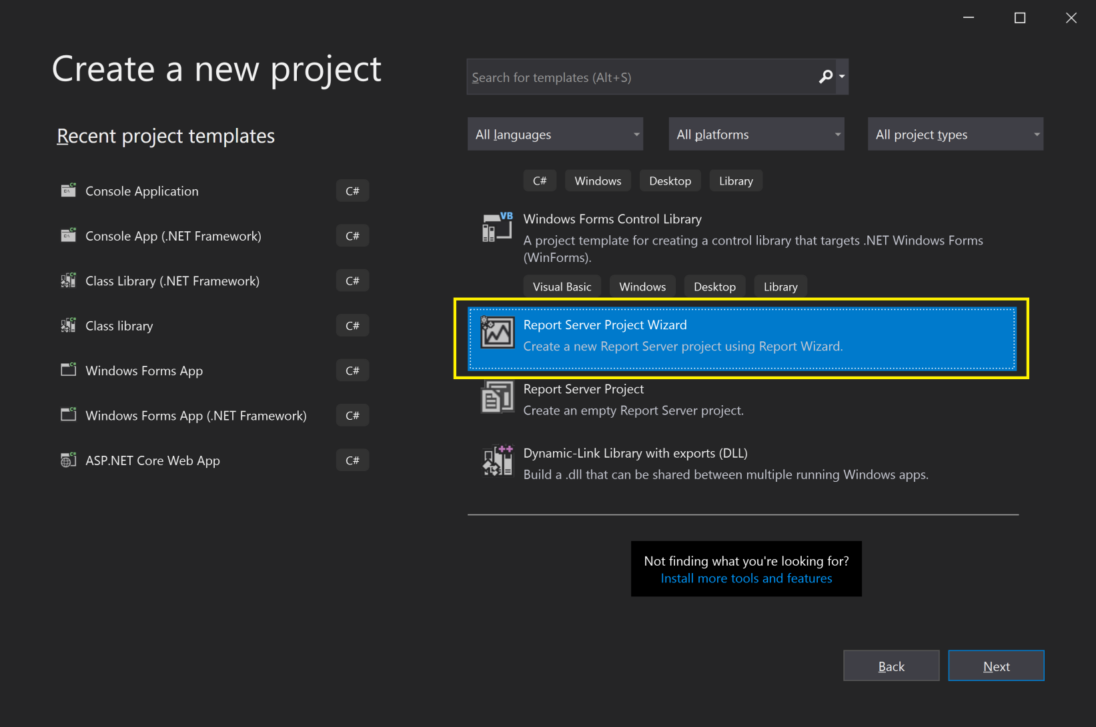
1. Create a Report Server Project Wizard
When using SSDT or Visual Studio, multiple reports are grouped together for you inside a project.

Slide 6
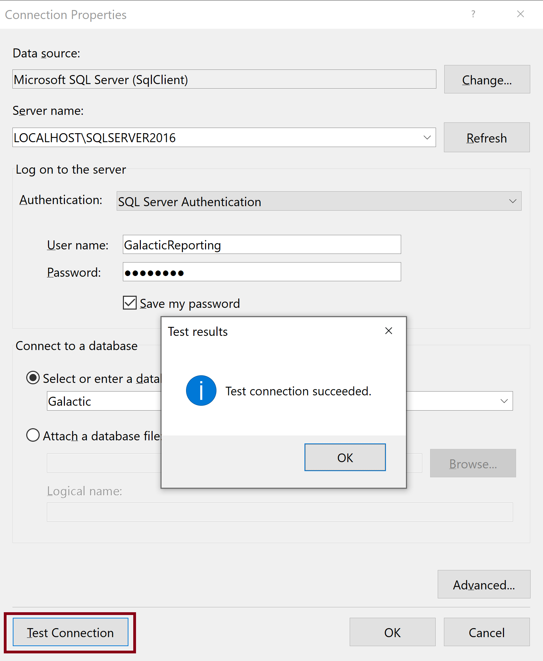
2. Select a Data Source

Slide 7
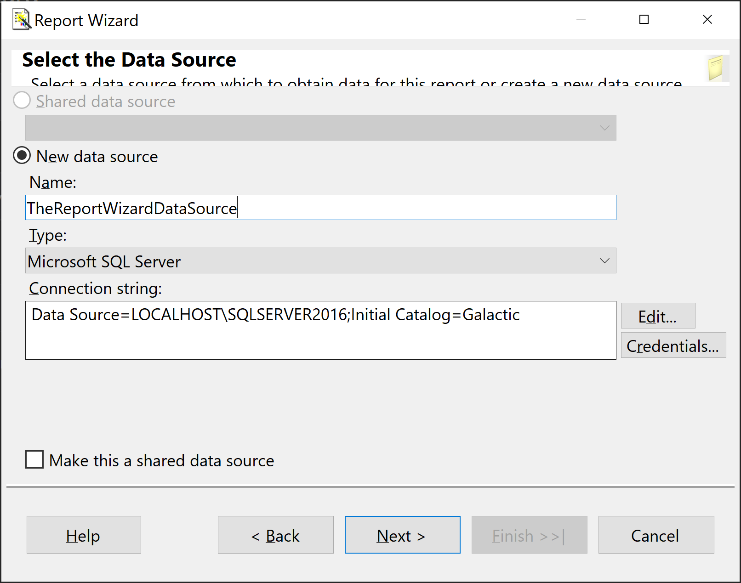
3. Enter Data Source Name

Slide 8
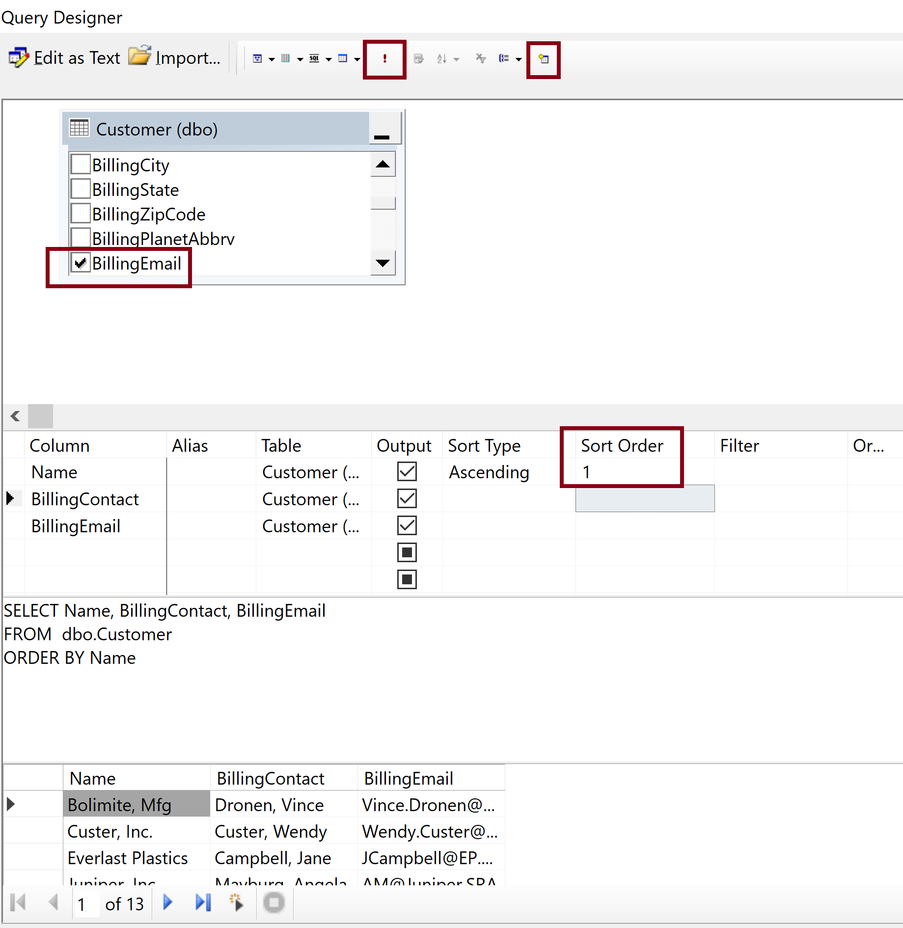
4. Create a Query

Slide 9
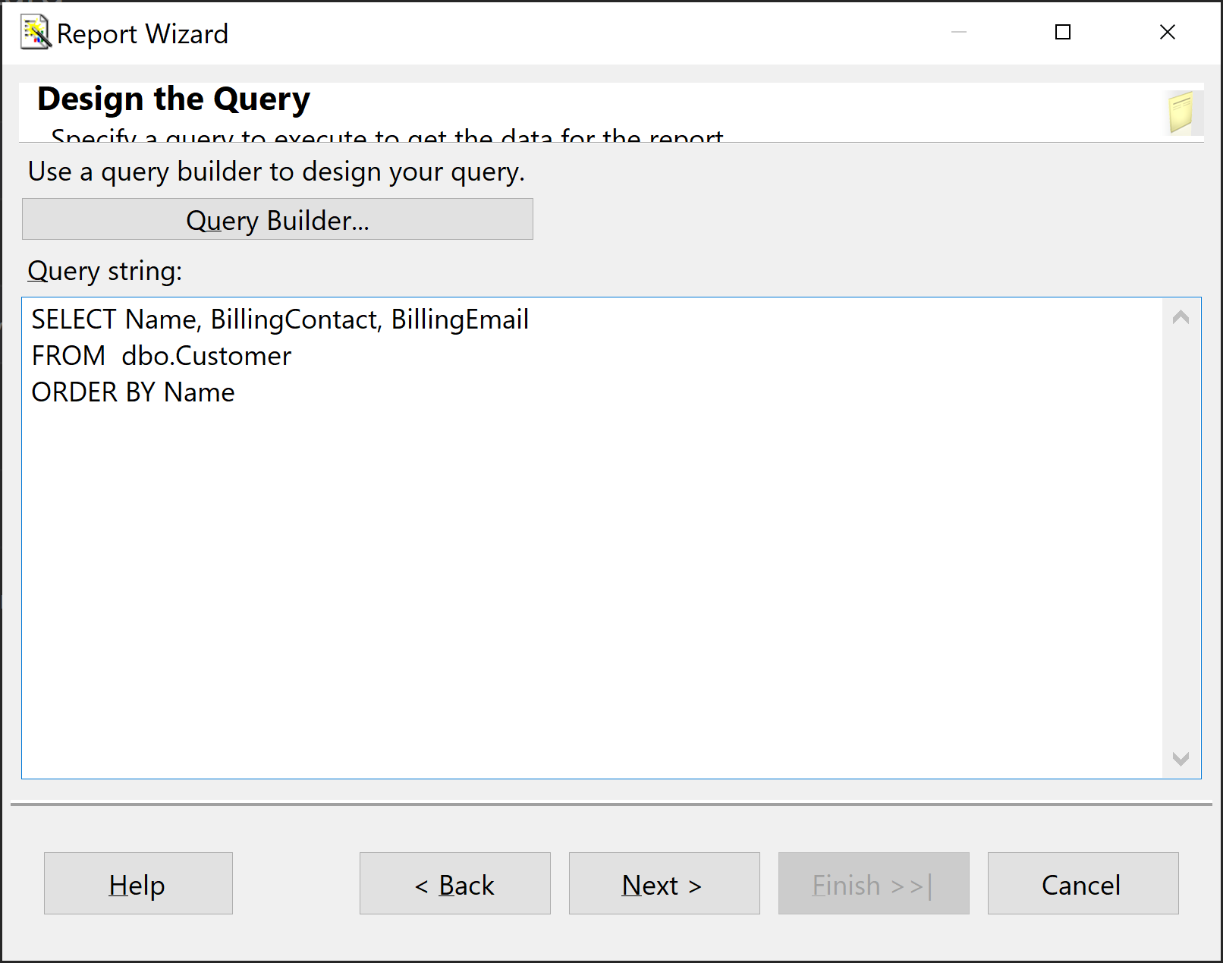
5. Review the Query

Slide 10
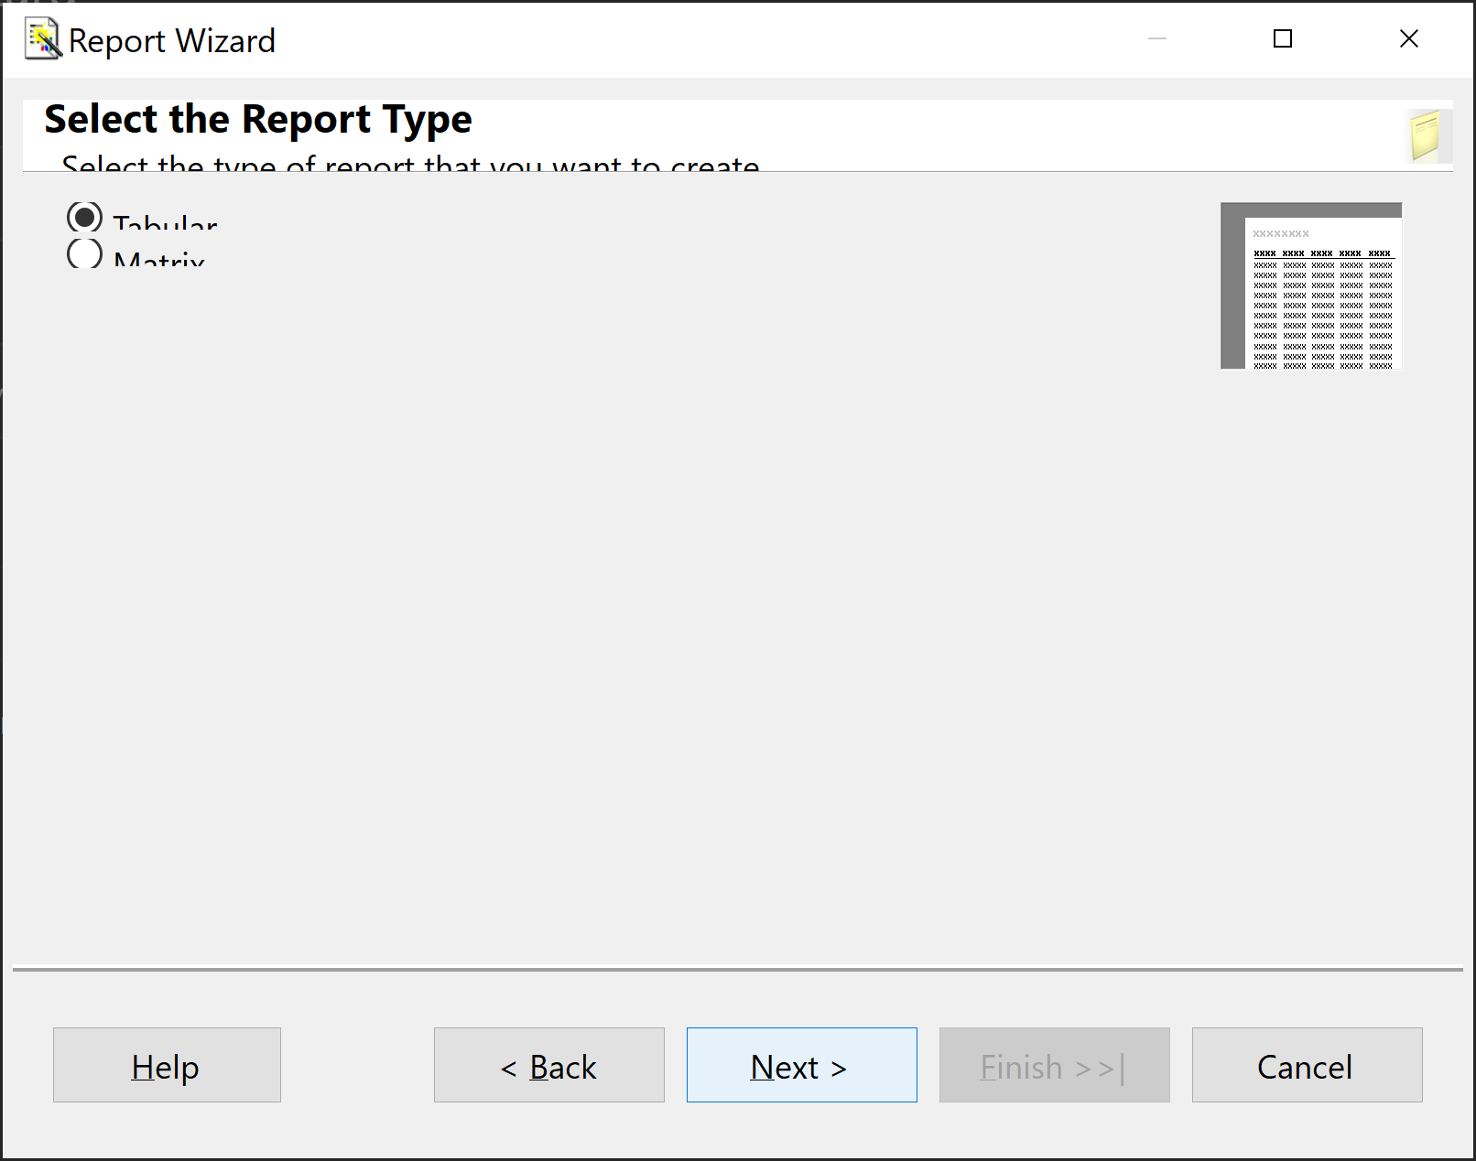
6. Select a Report Type

Slide 11
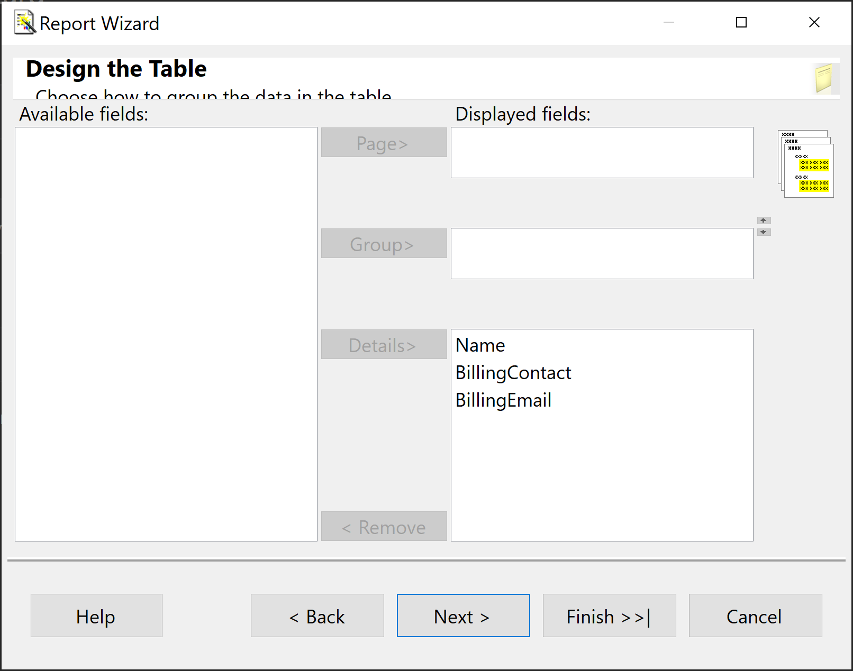
7. Select a Table Column Data

Slide 12
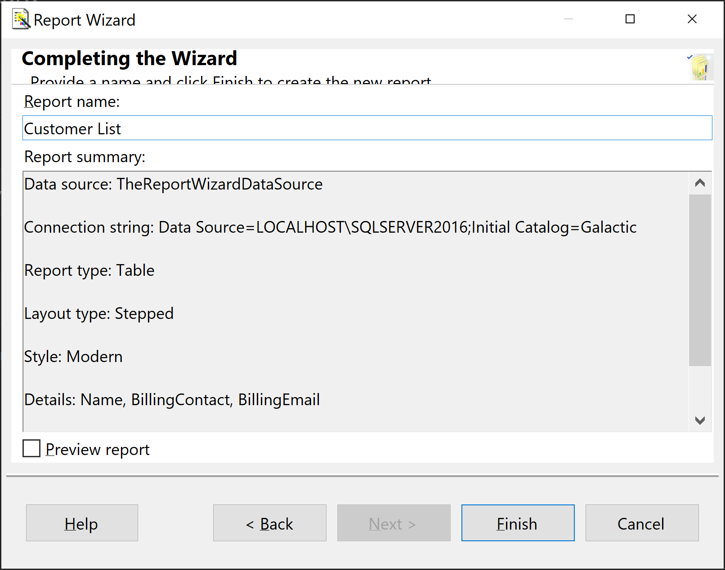
8. Enter a Report Name

Slide 13
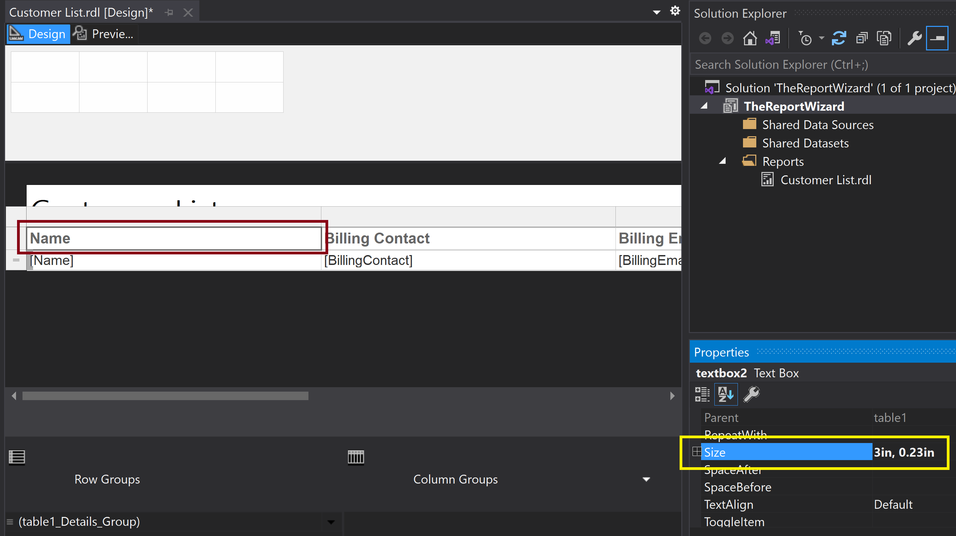
9. Change a Column Width
Click on a space of a column and ensure that a textbox is selected.

Slide 14
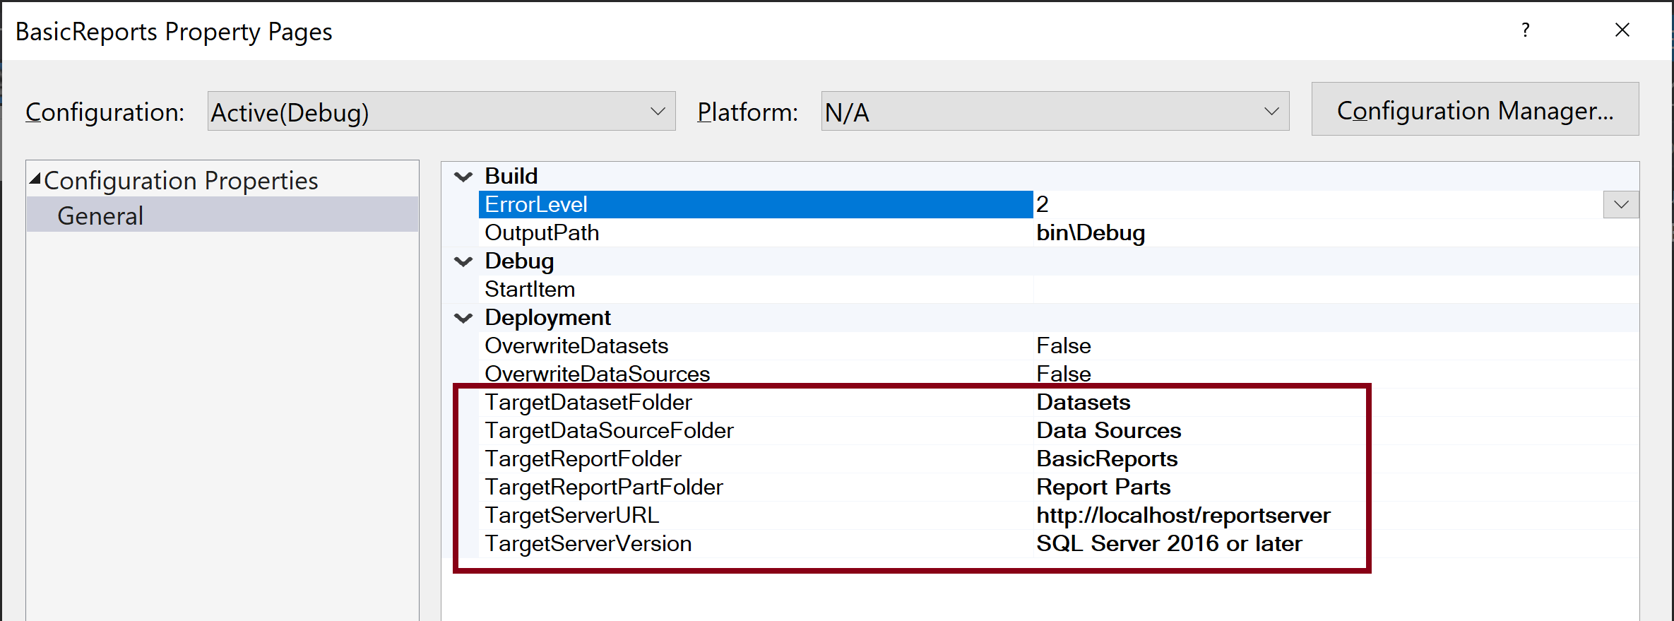
10. Edit Deployment Information
Right click a reporting project and select Properties.

Slide 15
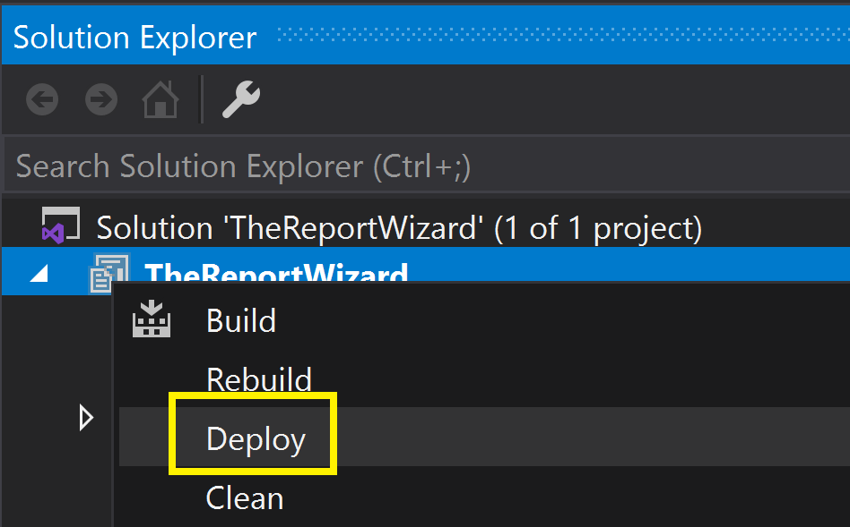
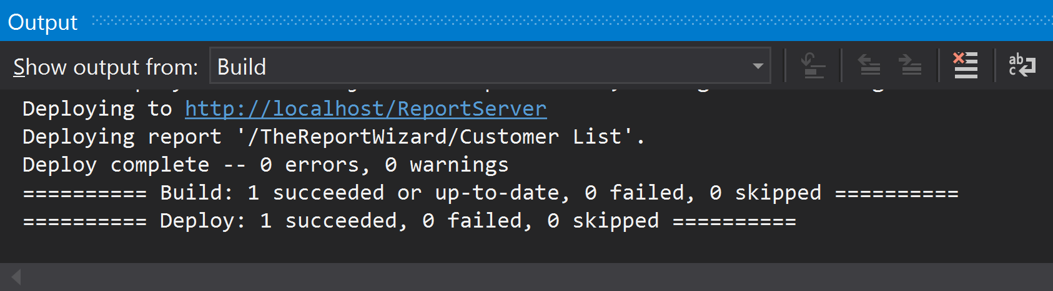
11. Deploy Report
Right click a reporting project and select Deploy.

Slide 16
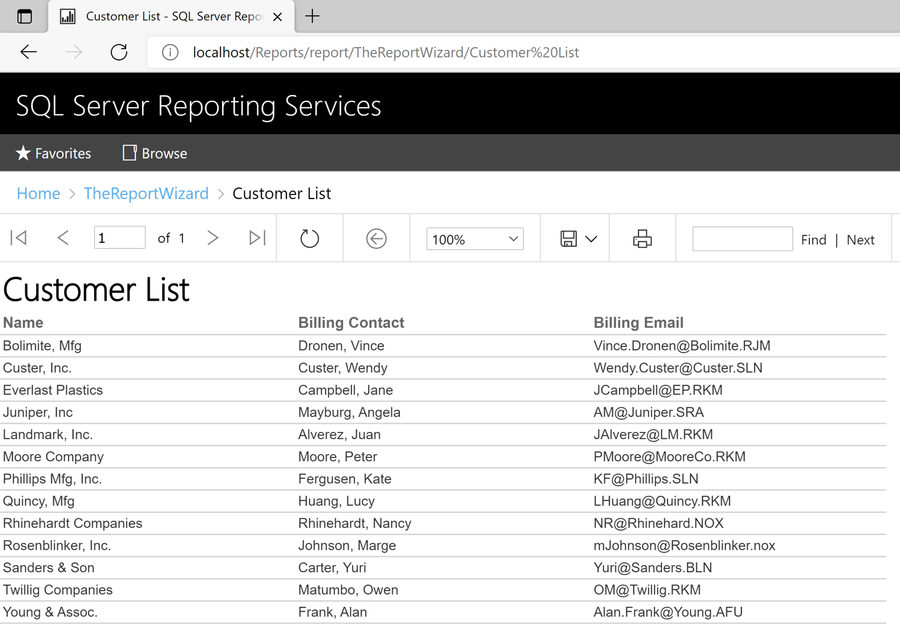
12. Test the Deployed Report
http://localhost/Reports/report/TheReportWizard/Customer%20List

Slide 17

Thank You & See You Again

